Slide 1
Track 5: Data Intelligence & AI
By: Dr Atul Kumar Ramotra

Slide 2
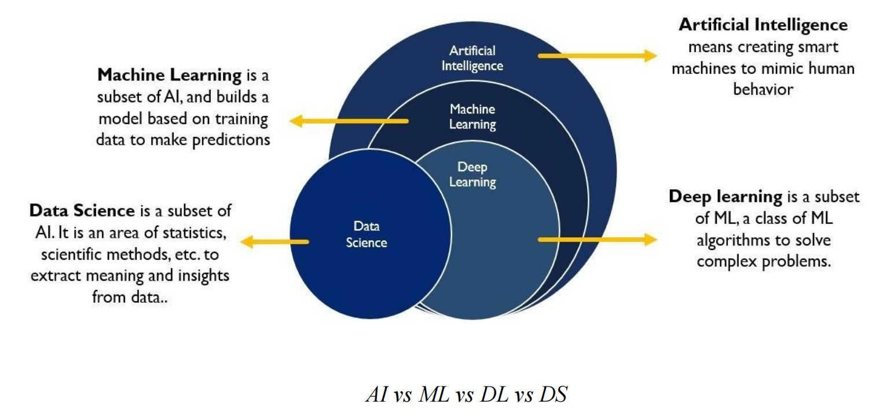
AI vs ML vs DL vs DS

Slide 3
Machine learning
Machine learning (ML) is a branch of artificial intelligence (AI) where computers learn from data to recognize patterns, make predictions, or take actions, without being explicitly programmed with fixed rules
Machine Learning techniques:
Supervised Learning
Unsupervised Learning
Semi-Supervised Learning

Slide 4
Supervised Learning
1. Supervised Learning
Uses labeled data, meaning each input is paired with a known correct output.
The model learns a mapping from inputs to outputs for tasks such as:
Classification (e.g. spam vs. non-spam email)
Regression (e.g. predicting house price)
Common algorithms:
Logistic Regression
Decision Trees,
kNN
Support Vector Machines (SVM)
Neural Networks

Slide 5
Unsupervised Learning
2. Unsupervised Learning
Works with unlabeled data. No predefined output is provided.
Model discovers structures, patterns, or groupings on its own.
Approaches:
Clustering (e.g. K‑Means, Hierarchical, DBSCAN): groups similar items together
Dimensionality Reduction (e.g. PCA, Autoencoders): compresses data while preserving structure
Association Rule Learning (e.g. Apriori, FP‑Growth): discovers relationships like “people who buy X also buy Y”
Applications: customer segmentation, anomaly detection, recommendation systems, pattern discovery in data

Slide 6
Semi-Supervised Learning
3. Semi-Supervised Learning
Hybrid between supervised and unsupervised.
Uses a small amount of labeled data plus a larger pool of unlabeled data.
The model learns from the labeled subset, then leverages that to label or structure the unlabeled portion
Useful when labeling data is expensive or labor-intensive (e.g. image recognition, text annotation)

Slide 7
Deep Learning (Neural Nets)
Deep Learning (Neural Nets)
A sub-field of ML using multi-layer artificial neural networks to process high‑dimensional data (images, text, signals)
Can be used in supervised, unsupervised, or reinforcement settings.
Examples of deep architectures: CNNs, RNNs, Transformers, Autoencoders, GANs

Slide 8
Logistic Regression
Logistic Regression is a supervised algorithm designed to predict the probability of a binary outcome (e.g., yes/no or 0/1) using one or more input features.
It applies a sigmoid (logistic) function to a linear combination of the features to map values into a probability between 0 and 1.
f(x) = 1 / (1 + e^{-x})
The predicted probability is often converted into class labels using a threshold (like 0.5, but adjustable)

Slide 9
Logistic Regression
Compute a weighted sum: 𝑧 =𝛽 ₀+𝛽 ₁𝑥 ₁ +⋯+𝛽 _{𝑛} 𝑥 _{𝑛}
Apply the sigmoid function:
𝑝 =1/1+𝑒 ^{−𝑧​}
giving the probability of class 1
Optimize the model by minimizing the cross-entropy (log-loss), typically via maximum likelihood estimation and gradient descent.
For binary classification (labels 0 or 1), the cross-entropy loss for one prediction is:
L = − [ y * log⁡(p)+(1−y) * log⁡(1−p) ]
y∈{0,1} → true label
p∈[0,1] → predicted probability of class 1
Make decisions using probability thresholding (e.g. classify as positive if 𝑝 >0.5).

Slide 10
Decision Tree
A Decision Tree is a supervised learning model used for both classification and regression tasks. It represents decisions and their possible outcomes as a tree structure:
Internal nodes: represent feature-based tests
Branches: correspond to test outcomes
Leaf nodes: produce final outputs (class label or numeric prediction)
Think of it as a flowchart that mimics human decision-making—easy to follow and interpret

Slide 11
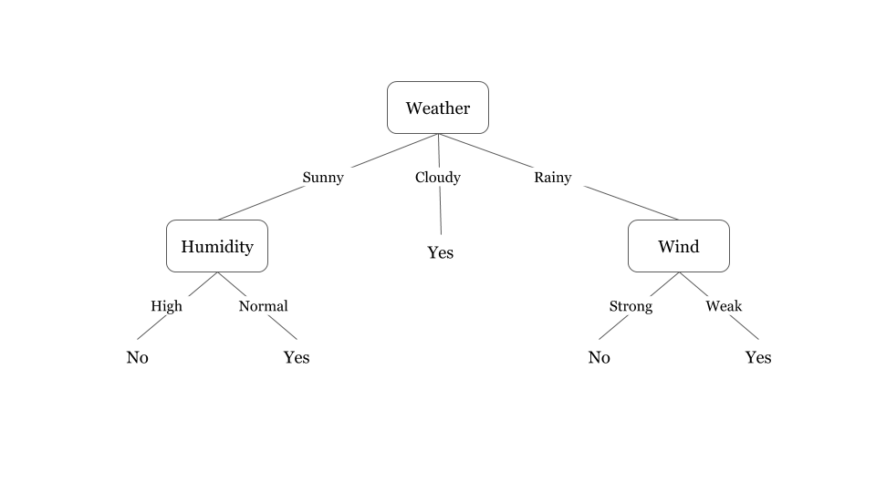
Decision Tree

Slide 12
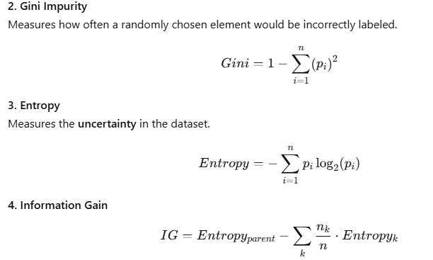
Decision Tree

Slide 13
Decision Tree Working
Start at the root node with the full dataset.
Choose a feature to split based on criteria like:
Entropy (used by ID3, C4.5)
Gini Index (used by CART)
Calculate Information Gain
Split the data into subsets and repeat recursively on each branch with unused features.
Stop when:
All samples in a subset belong to one class
No features remain
Prediction: traverse from root to a leaf node using feature values of a new instance to get the outcome.
Popular algorithms:
ID3: uses information gain, handles only categorical data, no pruning
C4.5: successor to ID3; handles continuous data, missing values, uses gain ratio, and supports post‑pruning
CART: supports classification and regression; uses Gini impurity and enables pruning; capable of handling mixed data types

Slide 14
k‑Nearest Neighbors
k‑NN is instance‑based algorithm for supervised learning, used in both classification and regression
It makes predictions based on the labels (or values) of the nearest training examples in feature space
Since it memorizes the training dataset and defers all computation until prediction time, it's often called a lazy learner or memory-based method
k‑NN Working:
Choose k, the number of neighbors.
Compute distance (e.g. Euclidean, Manhattan) between the new sample and all training examples.
Select the k closest neighbors.
Predict:
Classification: majority vote among neighbors' classes.

Slide 15
Naïve Bayes
It’s called:
"Naive" → because it assumes all features are independent (which is often not true in reality).
"Bayes" → because it’s based on Bayes' Theorem from probability
Bayes' Theorem (Core Formula)
P(C∣X)=P(X∣C)⋅P(C)/P(X)
Where:
C: Class (e.g., spam, not spam)
X: Features (e.g., words in an email)
P(C∣X): Posterior probability → probability of class given features
P(X∣C): Likelihood → probability of features given class
P(C): Prior → how common the class is
P(X): Evidence → probability of the features (same for all classes)

Slide 16
Naive Assumption
Naive Bayes assumes that:
𝑃 ( 𝑋 ∣𝐶 ) = 𝑃 (𝑥 1∣𝐶 )⋅𝑃 (𝑥 2∣𝐶 )…𝑃 (𝑥 𝑛∣𝐶 )
How Naive Bayes Works
Training:
Calculate the prior P(C) for each class.
Calculate the likelihood P(xi​∣C) for each feature in each class.
Prediction:
For a new data point with features x1​,x2​,...,xn​:
Compute P(C∣X) for each class using Bayes' theorem.
Pick the class with the highest probability.

Slide 17
Support Vector Machine
A Support Vector Machine is a powerful supervised learning algorithm primarily used for classification (but also for regression, as SVR).
It seeks the hyperplane that maximally separates classes by maximizing the margin—the distance between it and the closest data points, known as support vectors.
When data isn’t linearly separable, kernel functions transform data into a higher-dimensional space where separation is possible—without explicitly computing the transformation.
Common kernels include RBF/Gaussian, Polynomial, Linear, and Sigmoid.
The regularization parameter C balances margin width and classification errors—higher C reduces tolerance for misclassifications.

Slide 18
Confusion Matrix
Term | Full Form | Meaning
TP | True Positive | Model predicted 1, and the actual class was also 1 (correctly identified as positive).
TN | True Negative | Model predicted 0, and the actual class was also 0 (correctly identified as negative).
FP | False Positive | Model predicted 1, but the actual class was 0 (wrongly labeled as positive). Also called Type I Error.
FN | False Negative | Model predicted 0, but the actual class was 1 (wrongly labeled as negative). Also called Type II Error.
 | Predicted Positive | Predicted Negative
Actual Positive | True Positive (TP) | False Negative (FN)
Actual Negative | False Positive (FP) | True Negative (TN)
Predicted
| 0 | 1 |
---------------------
0 | TN | FP |
Actual ---------------------
1 | FN | TP |

Slide 19
Metrics Derived
Accuracy = (TP + TN) / (TP+TN+FP+FN)
Overall correctness
Precision = TP / (TP + FP)
Of predicted positives, how many are truly positive?
Recall (Sensitivity) = TP / (TP + FN)
Of actual positives, how many were correctly predicted?
F1-Score = 2 × (Precision × Recall) / (Precision + Recall)
Balance between precision and recall
Specificity = TN / (TN + FP)
Correct identification of negatives

Slide 20
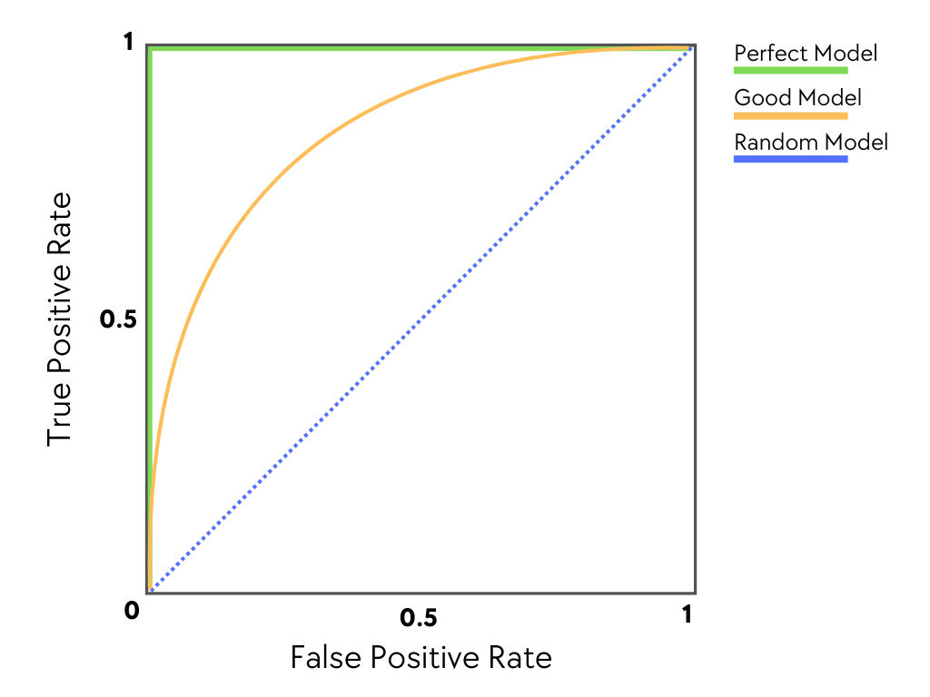
ROC
ROC (Receiver Operating Characteristic) Curve is a graphical plot used to evaluate the performance of binary classification models.
It plots True Positive Rate (TPR) against False Positive Rate (FPR) at various threshold settings.
Axes:
Y-axis (TPR / Recall):
TPR= {TP}/{TP + FN} ​
X-axis (FPR):
FPR={FP}/{FP + TN}
A perfect model would have a TPR of 1 and an FPR of 0 for all decision thresholds. This indicates that the model accurately identifies all positive instances while making no errors in predicting negative classes as positive

Slide 21
AUC
AUC stands for Area Under the ROC Curve. It summarizes the entire ROC curve into a single number.
Range: 0.0 to 1.0
Higher AUC = better model
AUC Score | Meaning
1.0 | Perfect classifier
0.9–0.99 | Excellent performance
0.8–0.9 | Good
0.7–0.8 | Fair
0.6–0.7 | Poor
0.5 | No skill (same as random guessing)
< 0.5 | Worse than random (model is inverted)

Slide 22
Regression Problem
A regression problem is when your target/output is continuous (numeric).
* Predict house price → ₹25,00,000
* Predict temperature → 32.5°C
* Predict salary → ₹8.2 LPA
Regression Algorithms
1. Linear Regression
* Assumes linear relationship
* Equation:
y = mx + c
* Simple, fast, baseline model
2. Multiple Linear Regression
* Multiple inputs:
y = w1x1 + w2x2 + ... + b
* House price based on size, rooms, location

Slide 23
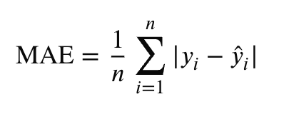
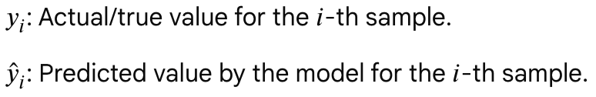
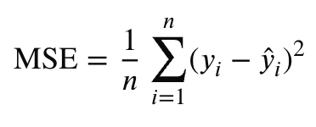
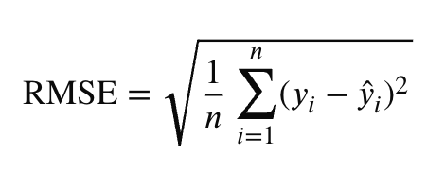
Evaluation Metrics
Mean Absolute Error (MAE): The average of absolute differences between predictions and actuals.
Strengths: Easily interpretable in the original target unit. It treats all errors equally, making it robust to outliers.
Mean Squared Error (MSE): The average of squared differences between predictions and actuals.
Strengths: Heavily penalizes large errors.
Root Mean Squared Error (RMSE): The square root of the MSE.
Strengths: Brings the error back to the same unit scale as your target variable. It is highly sensitive to outliers, which helps flag large, unacceptable errors.

Slide 24
Training and Testing
Train-Test Split (Holdout Method)
The train-test split is the standard, fast method for evaluating a machine learning model.
It is highly useful for large datasets where computational resources are limited.
How it works:
Data is divided into two mutually exclusive sets. The model learns patterns from the Training Set and its predictive power is evaluated on the unseen Test Set.
Best Used For:
Massive datasets with millions of rows, or resource-heavy models (like Deep Learning) where running multiple iterations takes too long.
Advantage:
Extremely fast and requires very little computing power.
Disatvantage:
Overfitting in small datasets.

Slide 25
Training and Testing
Cross-Validation (K-Fold)
Cross-validation solves the single-split instability problem by systematically swapping out which data points are used for training and testing.
How it works:
In k-fold cross-validation, the dataset is divided into k equal-sized subsets (or folds), typically 5 or 10. If k=5,
The model trains on 4 folds and evaluates on the 1 remaining fold. This repeats 5 times so that every fold gets a chance to be the test set.
The final score is the average of these 5 runs.
Best Used For:
Small to moderate-sized datasets where you need to maximize data usage and get a highly reliable, robust estimate of model performance

Slide 26
THANK YOU!
Text

